Slide 1
ECE 884 Deep Learning
Lecture 4: Nonparametric Model
01/28/2021

Slide 2
Review of last lecture
Other flavors of machine learning
Unsupervised learning
Semi-supervised learning
Active learning
Self-supervised learning
Reinforcement learning

Slide 3
Supervised Learning Formulation
y = f(x)
output
prediction function
input
Formulation:
Given training data: {(x₁,y₁), …, (x_{N},y_{N})},
Find y = f(x) ∈ " using training data
• such that f is correct on test data
Credit: Lazebnik, Liang

Slide 4
Supervised Learning Formulation
y = f(x)
Task#1: function form
output
prediction function
input
Formulation:
Given training data: {(x₁,y₁), …, (x_{N},y_{N})},
Find y = f(x) ∈ " using training data
• such that f is correct on test data
Credit: Lazebnik, Liang

Slide 5
Supervised Learning Formulation
y = f(x)
Task#2: how to tell whether f is good or bad?
output
prediction function
input
Formulation:
Given training data: {(x₁,y₁), …, (x_{N},y_{N})},
Find y = f(x) ∈ " using training data
• such that f is correct on test data
Credit: Lazebnik, Liang

Slide 6
Supervised Learning Formulation
y = f(x)
Task#3: how to train f?
output
prediction function
input
Formulation:
Given training data: {(x₁,y₁), …, (x_{N},y_{N})},
Find y = f(x) ∈ " using training data
• such that f is correct on test data
Credit: Lazebnik, Liang

Slide 7
Today’s lecture
Function form#1: nonparametric models

Slide 8

Nearest Neighbor Classifier (classification model)
Training examples from class 2
Training examples from class 1
Credit: Lazebnik

Slide 9
Nearest Neighbor Classifier (classification model)
Test example
Training examples from class 2
Training examples from class 1
f(x) = ?
Credit: Lazebnik

Slide 10
Nearest Neighbor Classifier (classification model)
Test example
Training examples from class 2
Training examples from class 1
f(x) = label of the training example nearest to x
• All we need is a distance metric for our inputs
• No training required!
Credit: Lazebnik

Slide 11
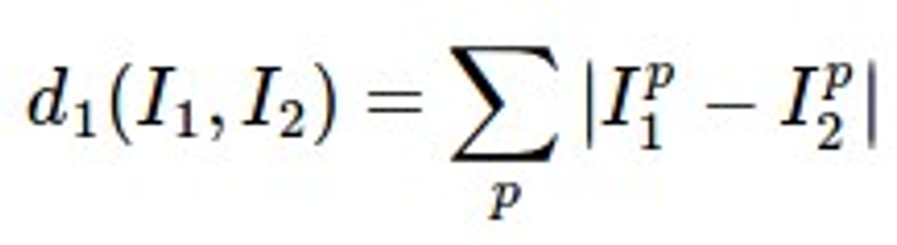
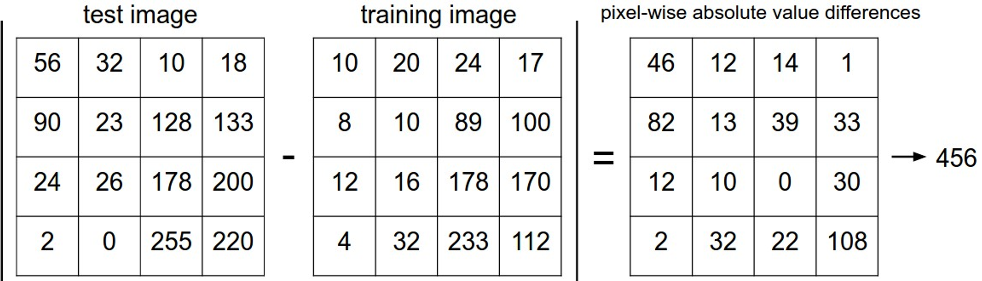
Distance Metric to compare images
L1 distance:
add
Credit: Justin

Slide 12
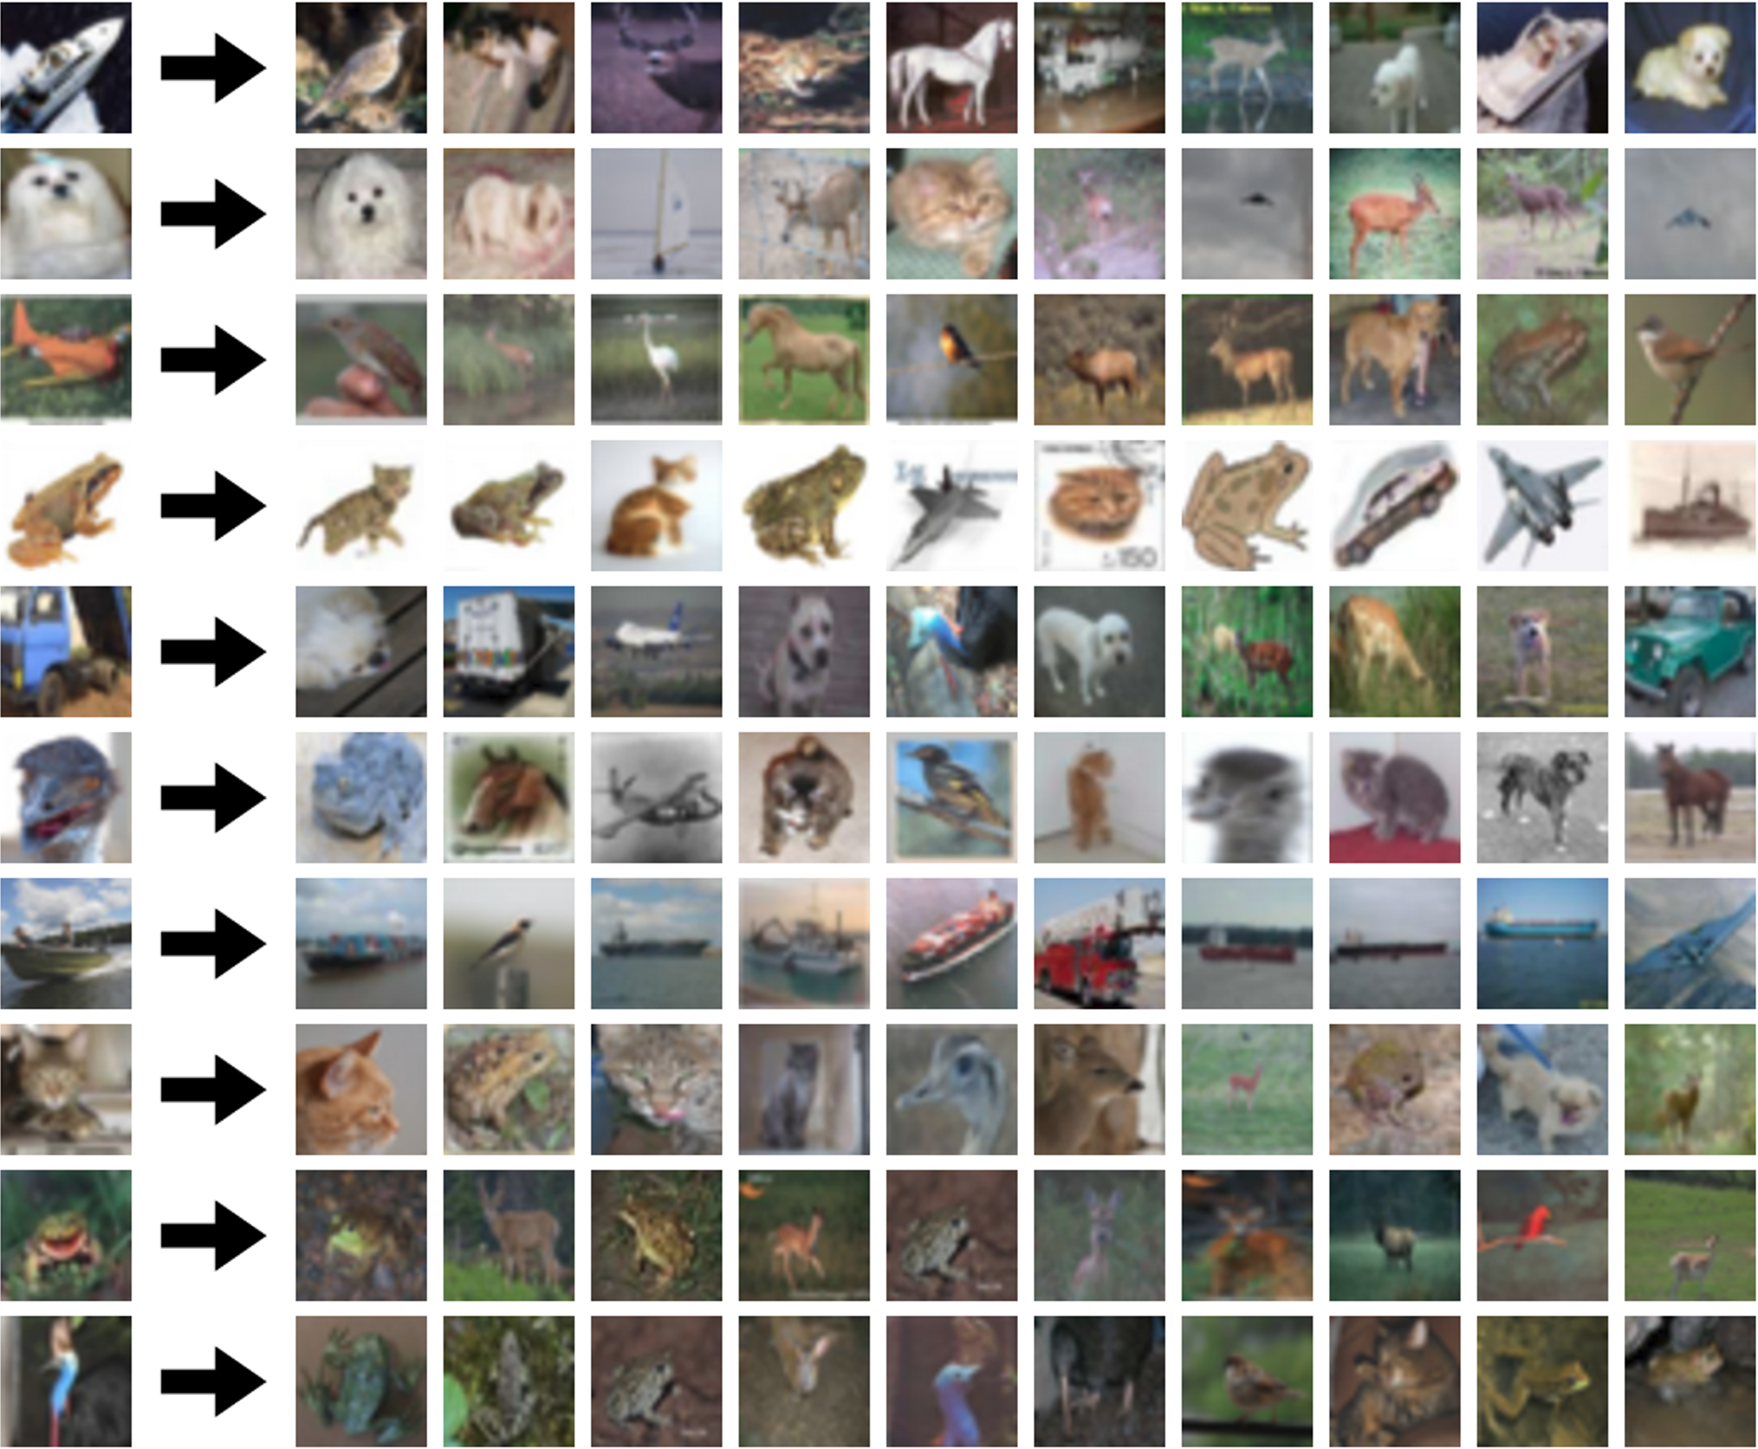
What does this look like?
Credit: Justin

Slide 13
What does this look like?
Credit: Justin

Slide 14
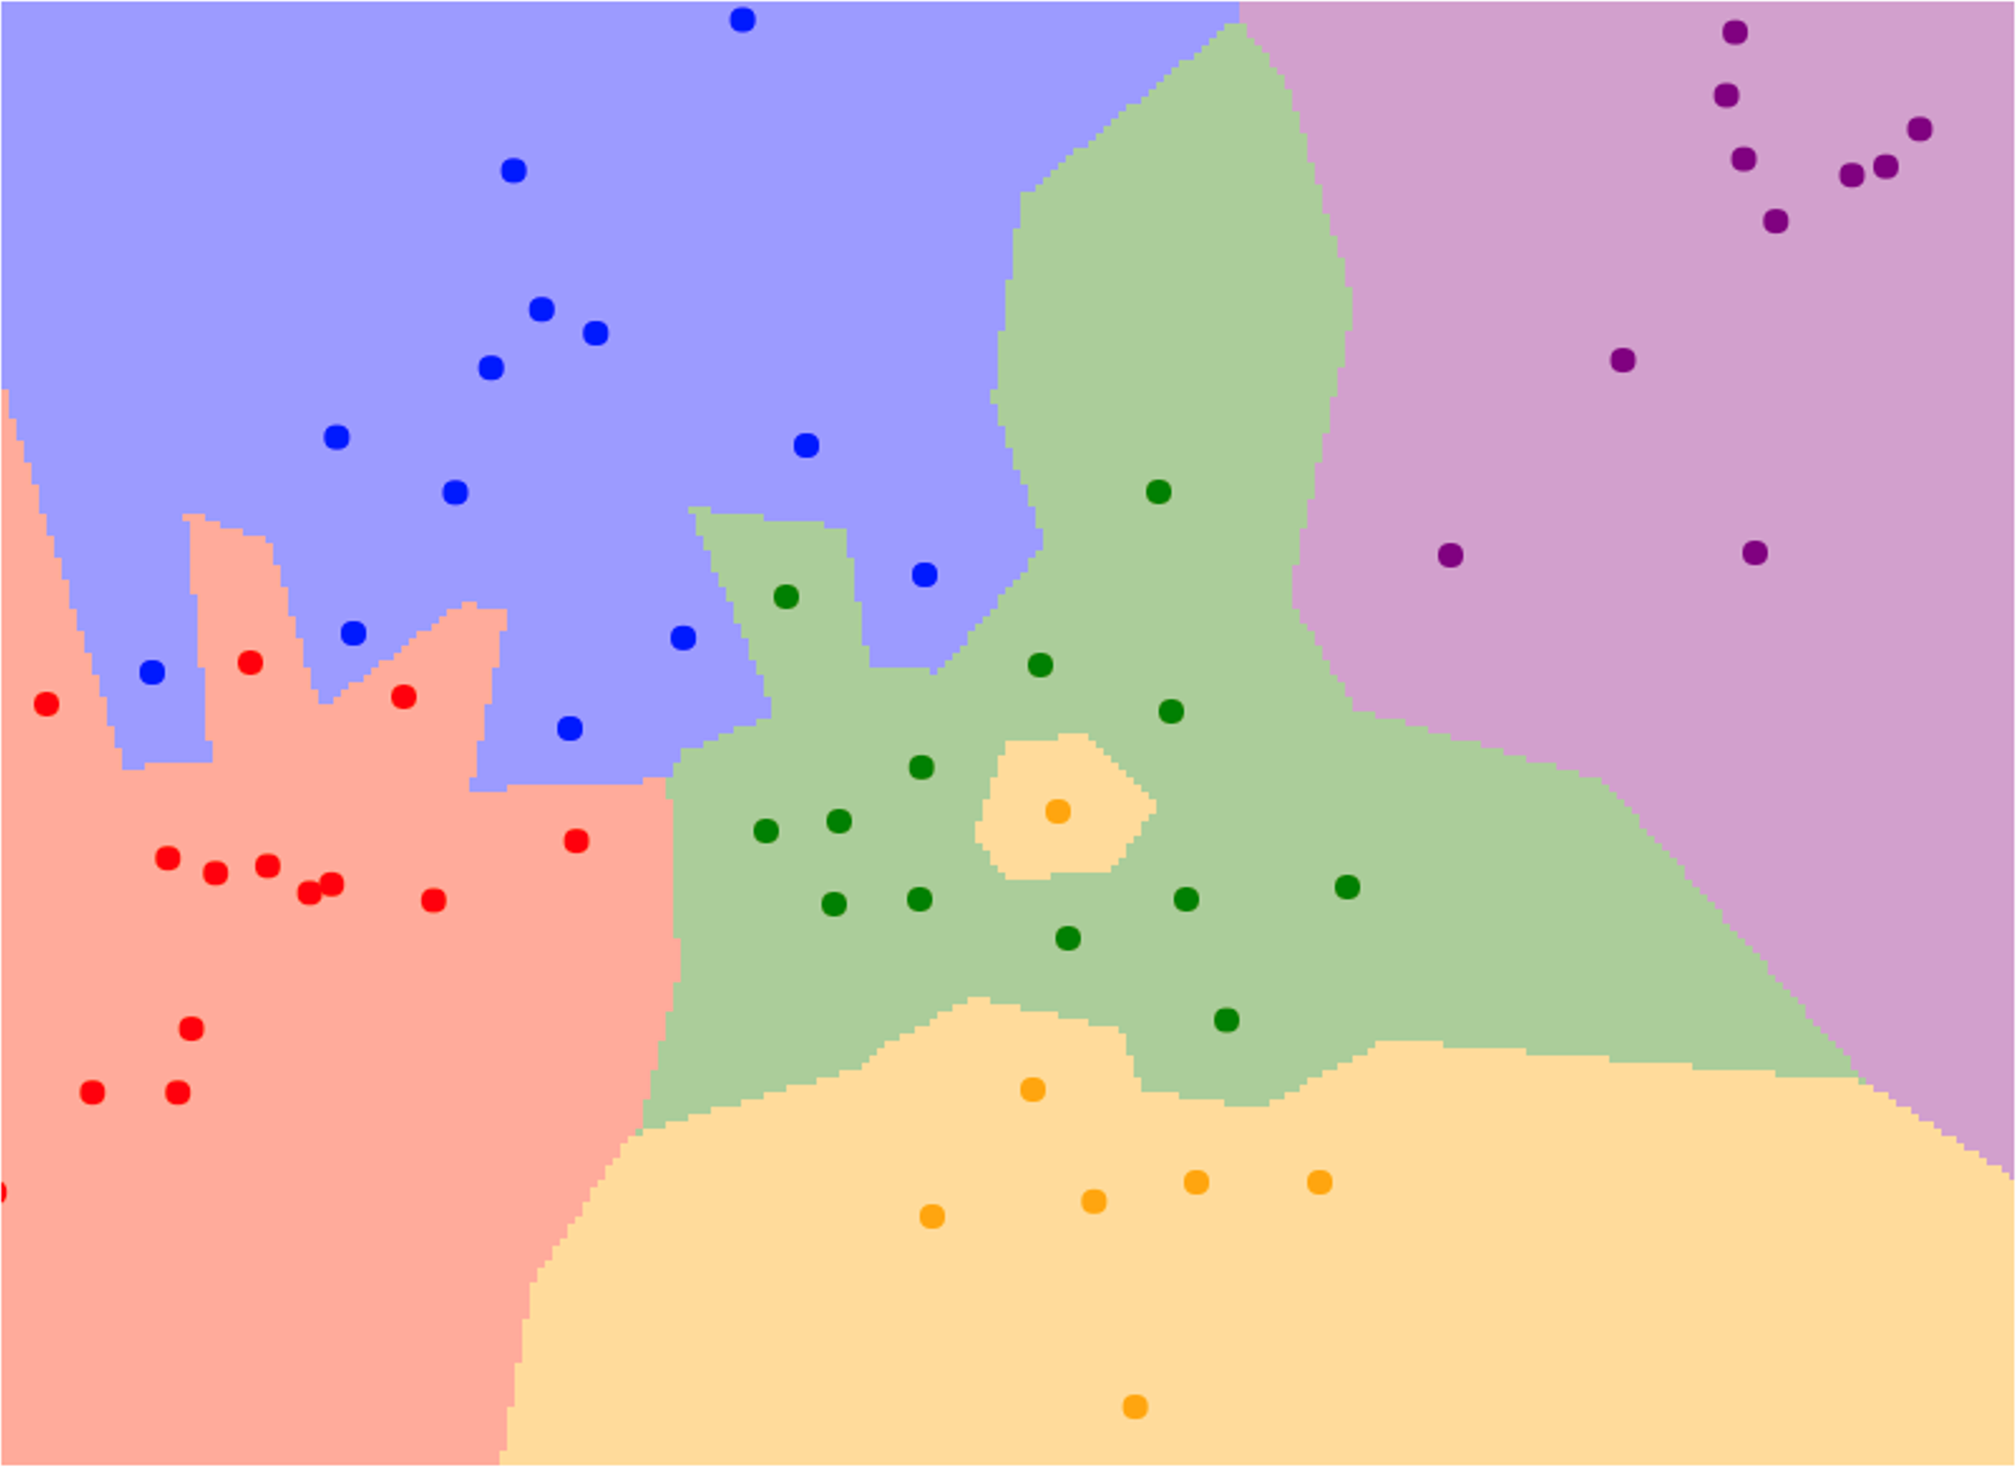
Nearest Neighbor Decision Boundaries
Credit: Justin

Slide 15
Nearest Neighbor Decision Boundaries
x₁
Nearest neighbors in two dimensions
Credit: Justin

Slide 16
Nearest Neighbor Decision Boundaries
x₁
Nearest neighbors in two dimensions
Points are training examples; colors give training labels
Credit: Justin

Slide 17
Nearest Neighbor Decision Boundaries
x₁
Nearest neighbors in two dimensions
Points are training examples; colors give training labels
Background colors give the category a test point would be assigned
x
Credit: Justin

Slide 18
Nearest Neighbor Decision Boundaries
x₁
Nearest neighbors in two dimensions
Decision boundary is the boundary between two classification regions
Points are training examples; colors give training labels
Background colors give the category a test point would be assigned
x
Credit: Justin

Slide 19
Nearest Neighbor Decision Boundaries
x₁
Nearest neighbors in two dimensions
Decision boundary is the boundary between two classification regions
Points are training examples; colors give training labels
Decision boundaries can be noisy; affected by outliers
Background colors give the category a test point would
x
be assigned
Credit: Justin

Slide 20
Nearest Neighbor Decision Boundaries
x₁
Nearest neighbors in two dimensions
Decision boundary is the boundary between two classification regions
Points are training examples; colors give training labels
Decision boundaries can be noisy; affected by outliers
Background colors give the category a test point would
How to smooth out decision boundaries? Use more neighbors!
x
be assigned
Credit: Justin

Slide 21

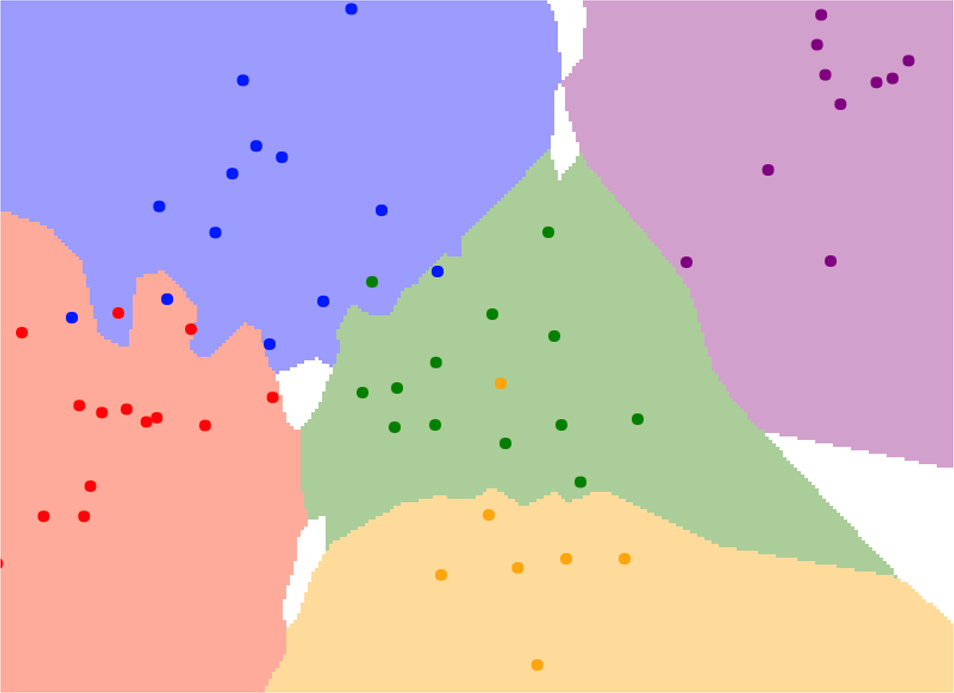
K-Nearest Neighbors
Instead of copying label from nearest neighbor, take majority vote from K closest points
K = 3
K = 1
Credit: Justin

Slide 22
K-Nearest Neighbors
Using more neighbors helps smooth out rough decision boundaries
K = 3
K = 1
Credit: Justin

Slide 23
K-Nearest Neighbors: Distance Metric
With the right choice of distance metric, we can apply K-Nearest Neighbor to any type of data!
Credit: Justin

Slide 24
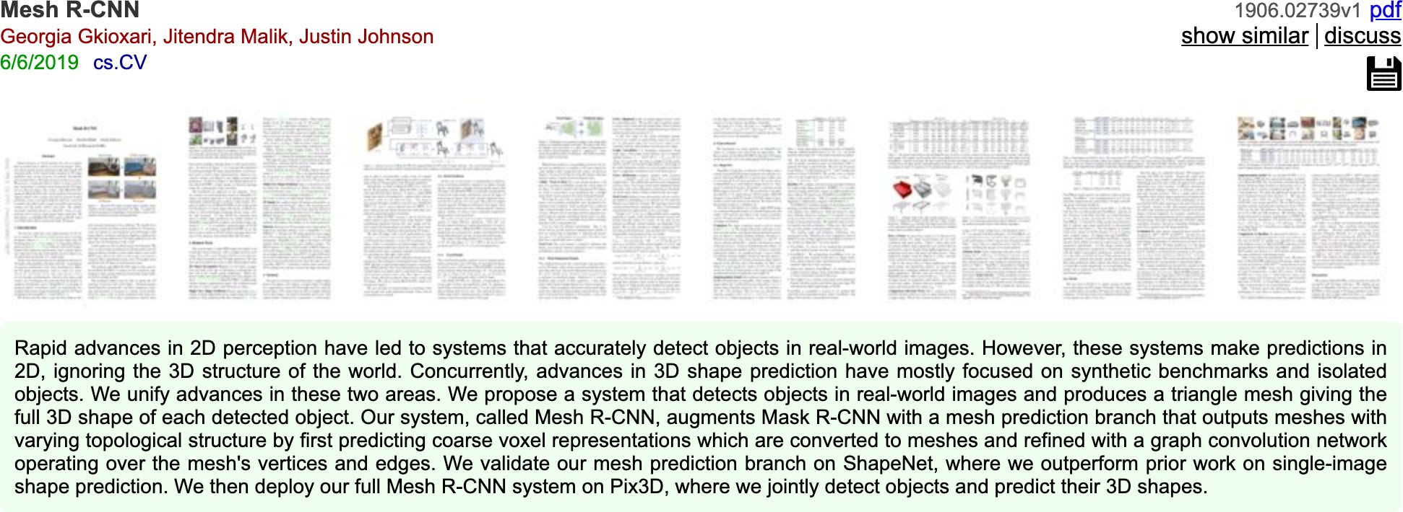
K-Nearest Neighbors: Distance Metric
With the right choice of distance metric, we can apply K-Nearest Neighbor to any type of data!
Example: Compare research papers using tf-idf similarity
http://www.arxiv-sanity.com/search?q=mesh+r-cnn
Credit: Justin

Slide 25
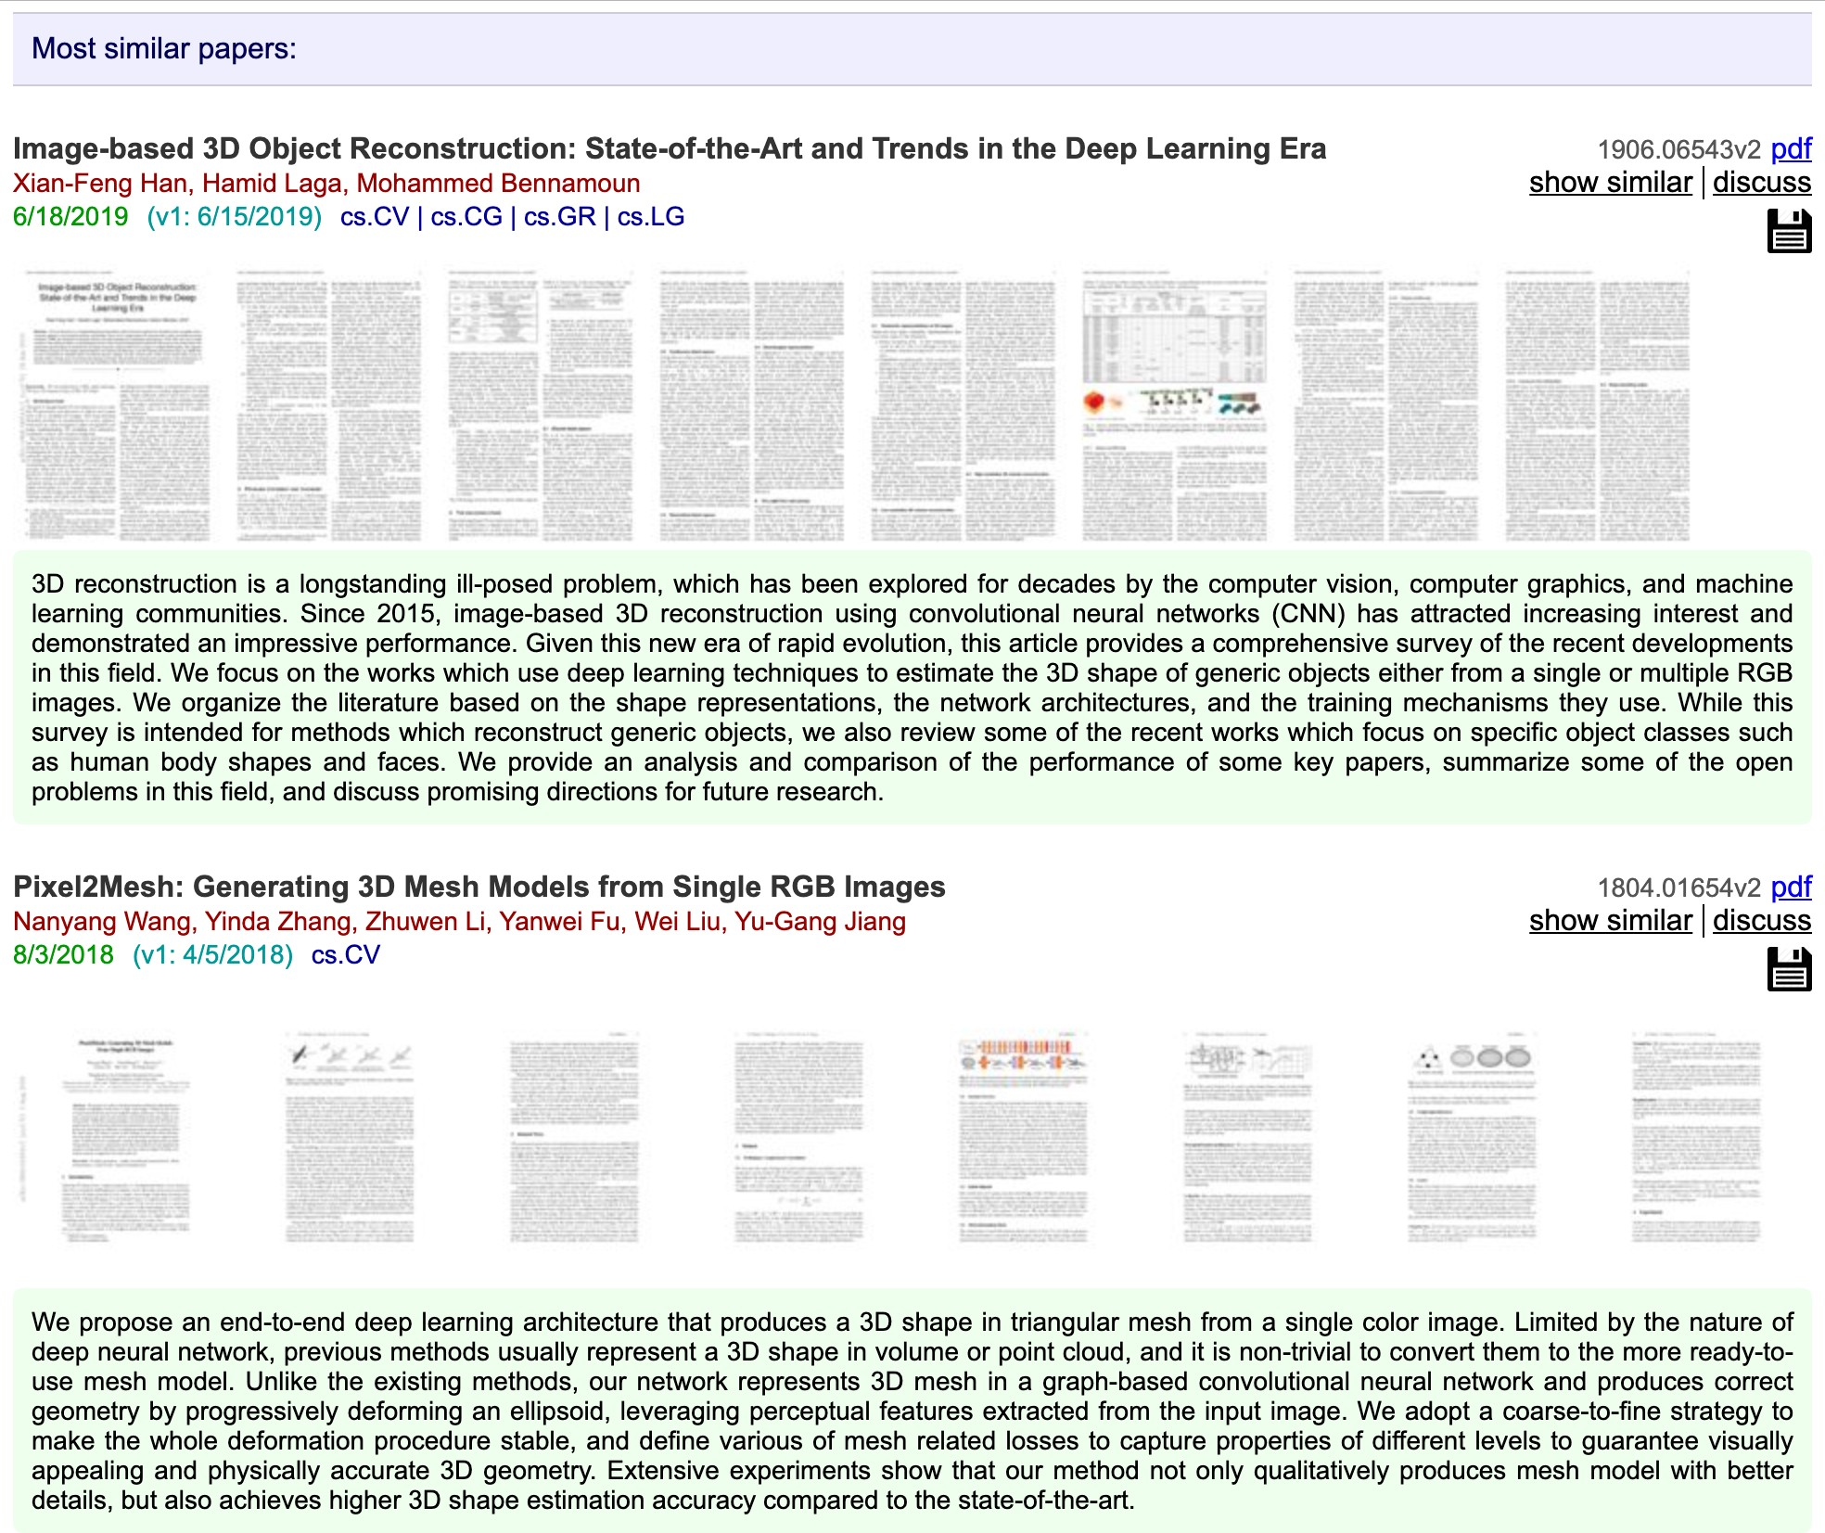
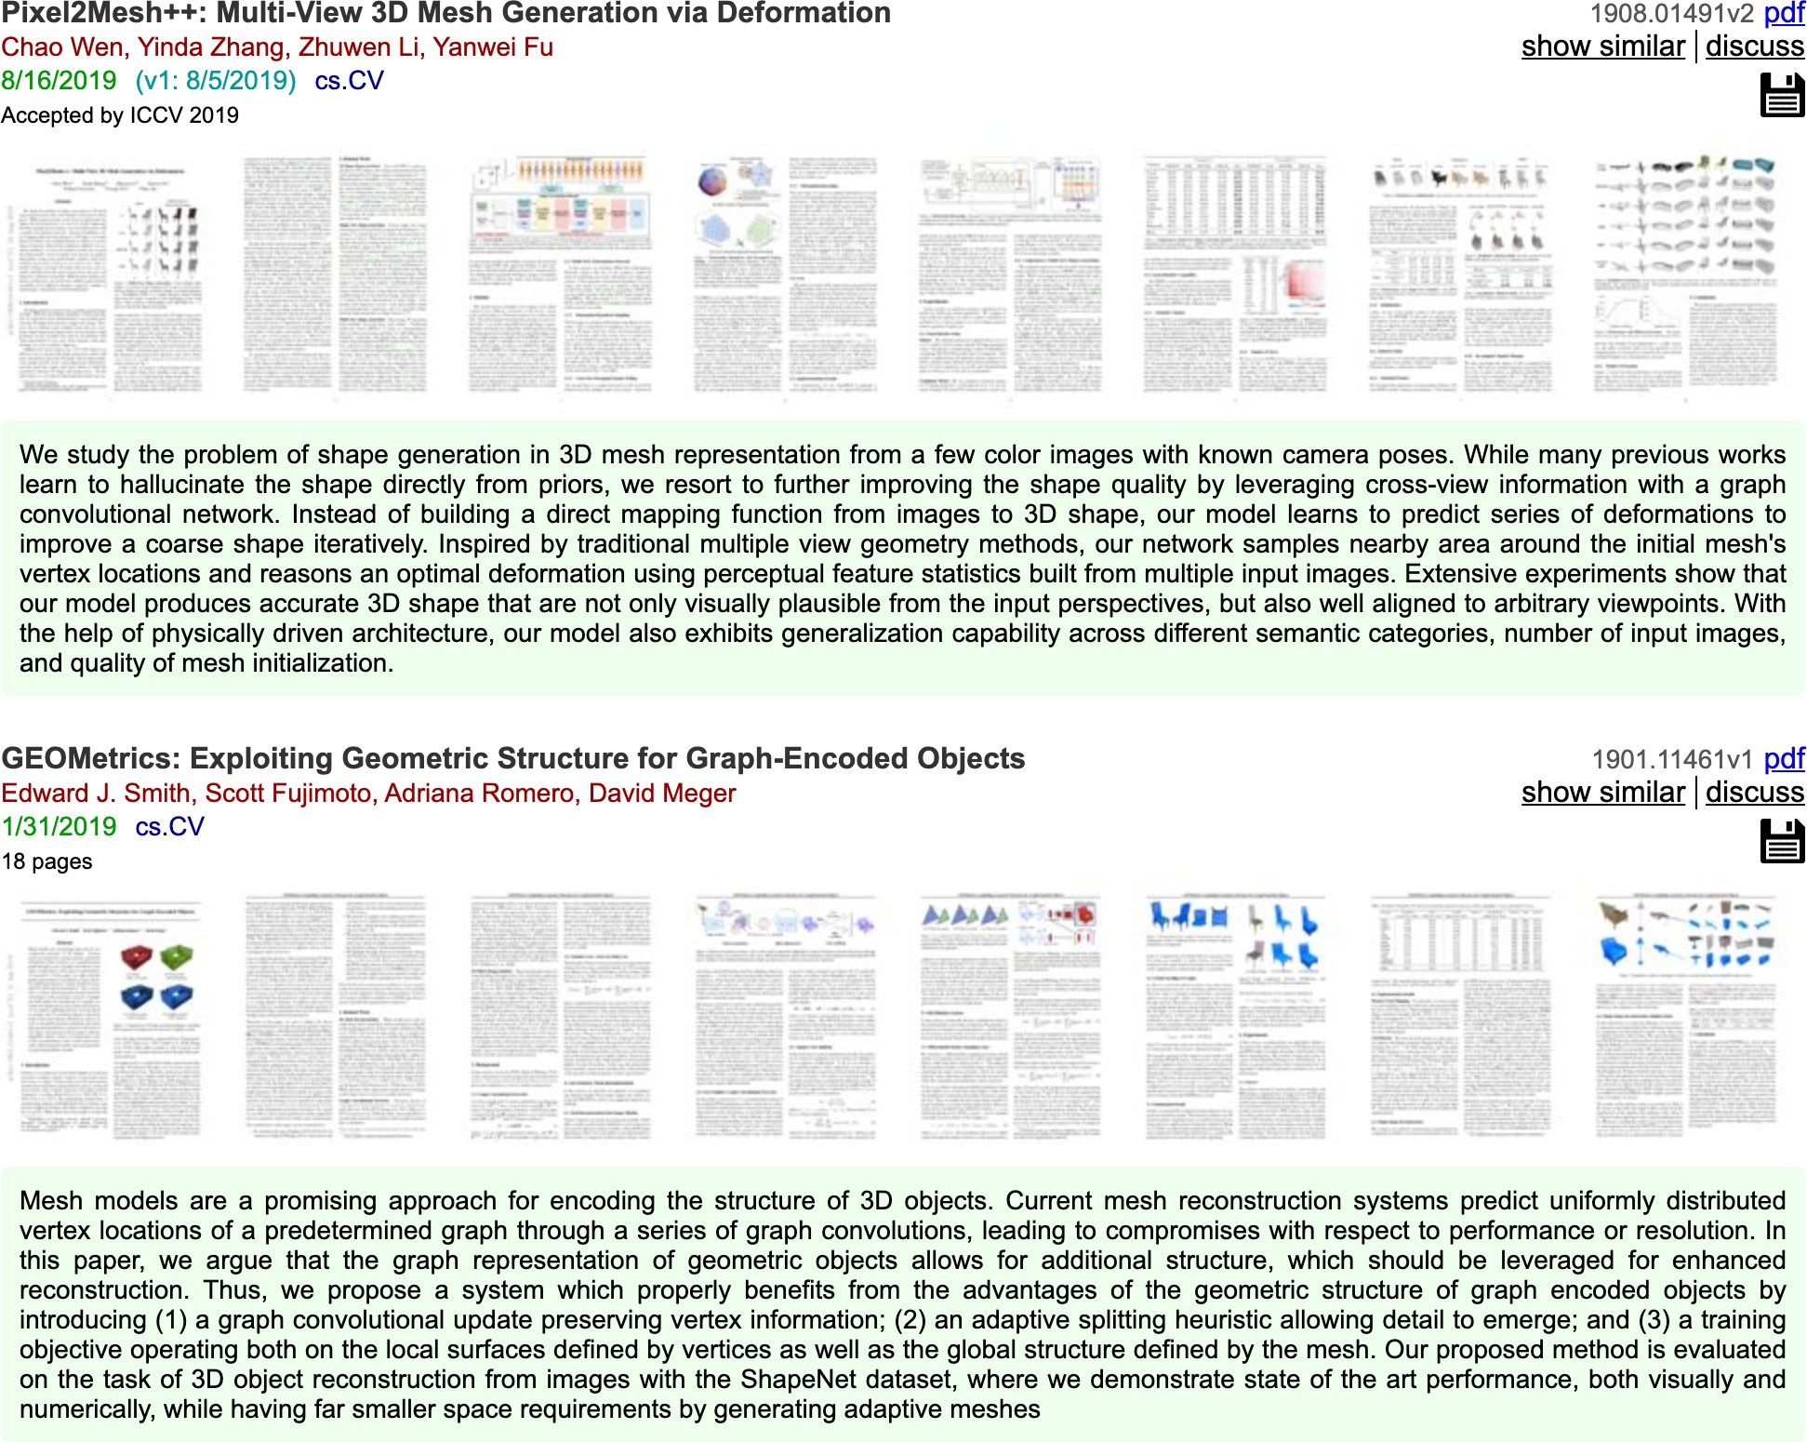
K-Nearest Neighbors: Distance Metric
Credit: Justin

Slide 26
Hyperparameters
What is the best value of K to use? What is the best distance metric to use?
These are examples of hyperparameters: choices about our learning algorithm that we don’t learn from the training data; instead we set them at the start of the learning process
Credit: Justin

Slide 27
Hyperparameters
What is the best value of K to use? What is the best distance metric to use?
These are examples of hyperparameters: choices about our learning algorithm that we don’t learn from the training data; instead we set them at the start of the learning process
Very problem-dependent. In general need to try them all and see what works best for our data / task.
Credit: Justin

Slide 28
Setting Hyperparameters
Idea #1: Choose hyperparameters that work best on the data
Your Dataset
Credit: Justin

Slide 29
Setting Hyperparameters
Idea #1: Choose hyperparameters that work best on the data
BAD: K = 1 always works perfectly on training data
Your Dataset
Credit: Justin

Slide 30
Setting Hyperparameters
Idea #1: Choose hyperparameters that work best on the data
BAD: K = 1 always works perfectly on training data
Your Dataset
Idea #2: Split data into train and test, choose hyperparameters that work best on test data
train
test
Credit: Justin

Slide 31
Setting Hyperparameters
Idea #1: Choose hyperparameters that work best on the data
BAD: K = 1 always works perfectly on training data
Your Dataset
Idea #2: Split data into train and test, choose hyperparameters that work best on test data
BAD: No idea how algorithm will perform on new data
train
test
Credit: Justin

Slide 32
Setting Hyperparameters
Idea #1: Choose hyperparameters that work best on the data
BAD: K = 1 always works perfectly on training data
Your Dataset
Idea #2: Split data into train and test, choose hyperparameters that work best on test data
BAD: No idea how algorithm will perform on new data
train
test
Idea #3: Split data into train, val, and test; choose hyperparameters on val and evaluate on test
Better!
train | validation | test
Credit: Justin

Slide 33
Setting Hyperparameters
Your Dataset
Idea #4: Cross-Validation: Split data into folds, try each fold as validation and average the results
fold 1 | fold 2 | fold 3 | fold 4 | fold 5 | test
fold 1 | fold 2 | fold 3 | fold 4 | fold 5 | test
fold 1 | fold 2 | fold 3 | fold 4 | fold 5 | test
Useful for small datasets, but (unfortunately) not used too frequently in deep learning
Credit: Justin

Slide 34
K-Nearest Neighbor: Universal Approximation
As the number of training samples goes to infinity, nearest neighbor can represent any^{(*)} function!
Credit: Justin

Slide 35
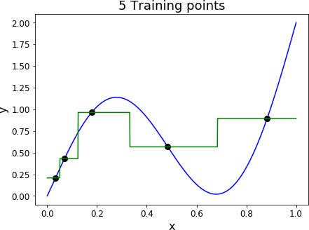
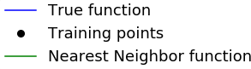
K-Nearest Neighbor: Universal Approximation
As the number of training samples goes to infinity, nearest neighbor can represent any^{(*)} function!
Credit: Justin

Slide 36
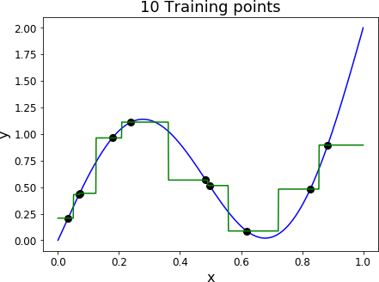
K-Nearest Neighbor: Universal Approximation
As the number of training samples goes to infinity, nearest neighbor can represent any^{(*)} function!
Credit: Justin

Slide 37
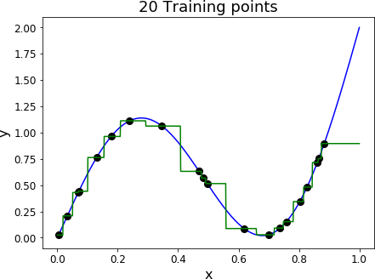
K-Nearest Neighbor: Universal Approximation
As the number of training samples goes to infinity, nearest neighbor can represent any^{(*)} function!
Credit: Justin

Slide 38
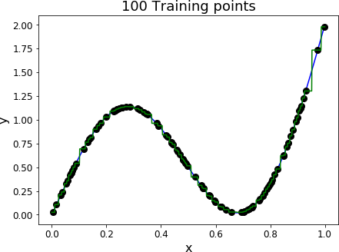
K-Nearest Neighbor: Universal Approximation
As the number of training samples goes to infinity, nearest neighbor can represent any^{(*)} function!
Credit: Justin

Slide 39
Problem: No Function
No function: you need to carry all the data
Credit: Justin

Slide 40
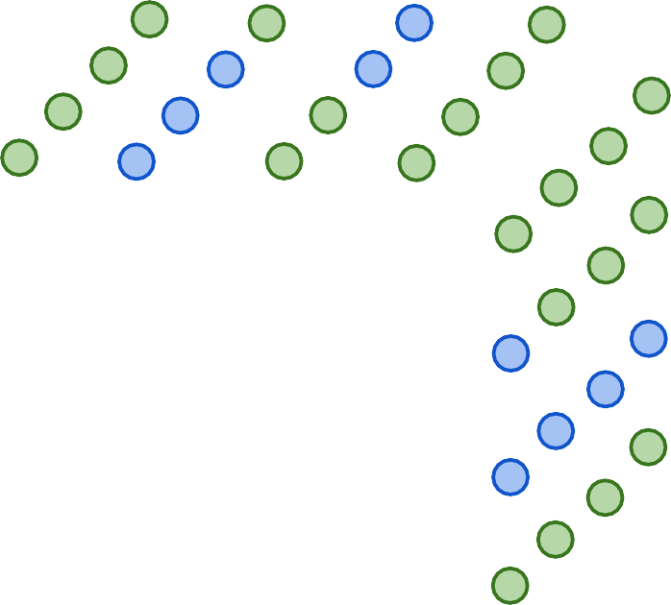











Problem: Curse of Dimensionality
Curse of dimensionality: For uniform coverage of space, number of training points needed grows exponentially with dimension
Dimensions = 2
Points = 4²
Dimensions = 3
Points = 4³
Dimensions = 1
Points = 4
Credit: Justin

Slide 41
Any Question ?

